Slide 1
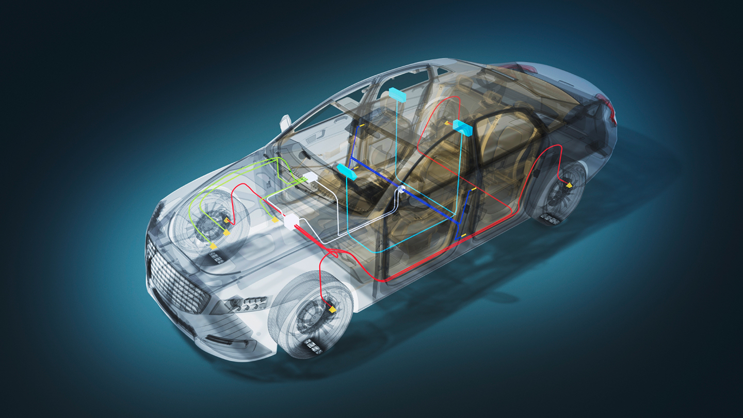
Controller Area Network
FOR BRAKE SYSTEM IN VEHICLES

Slide 2
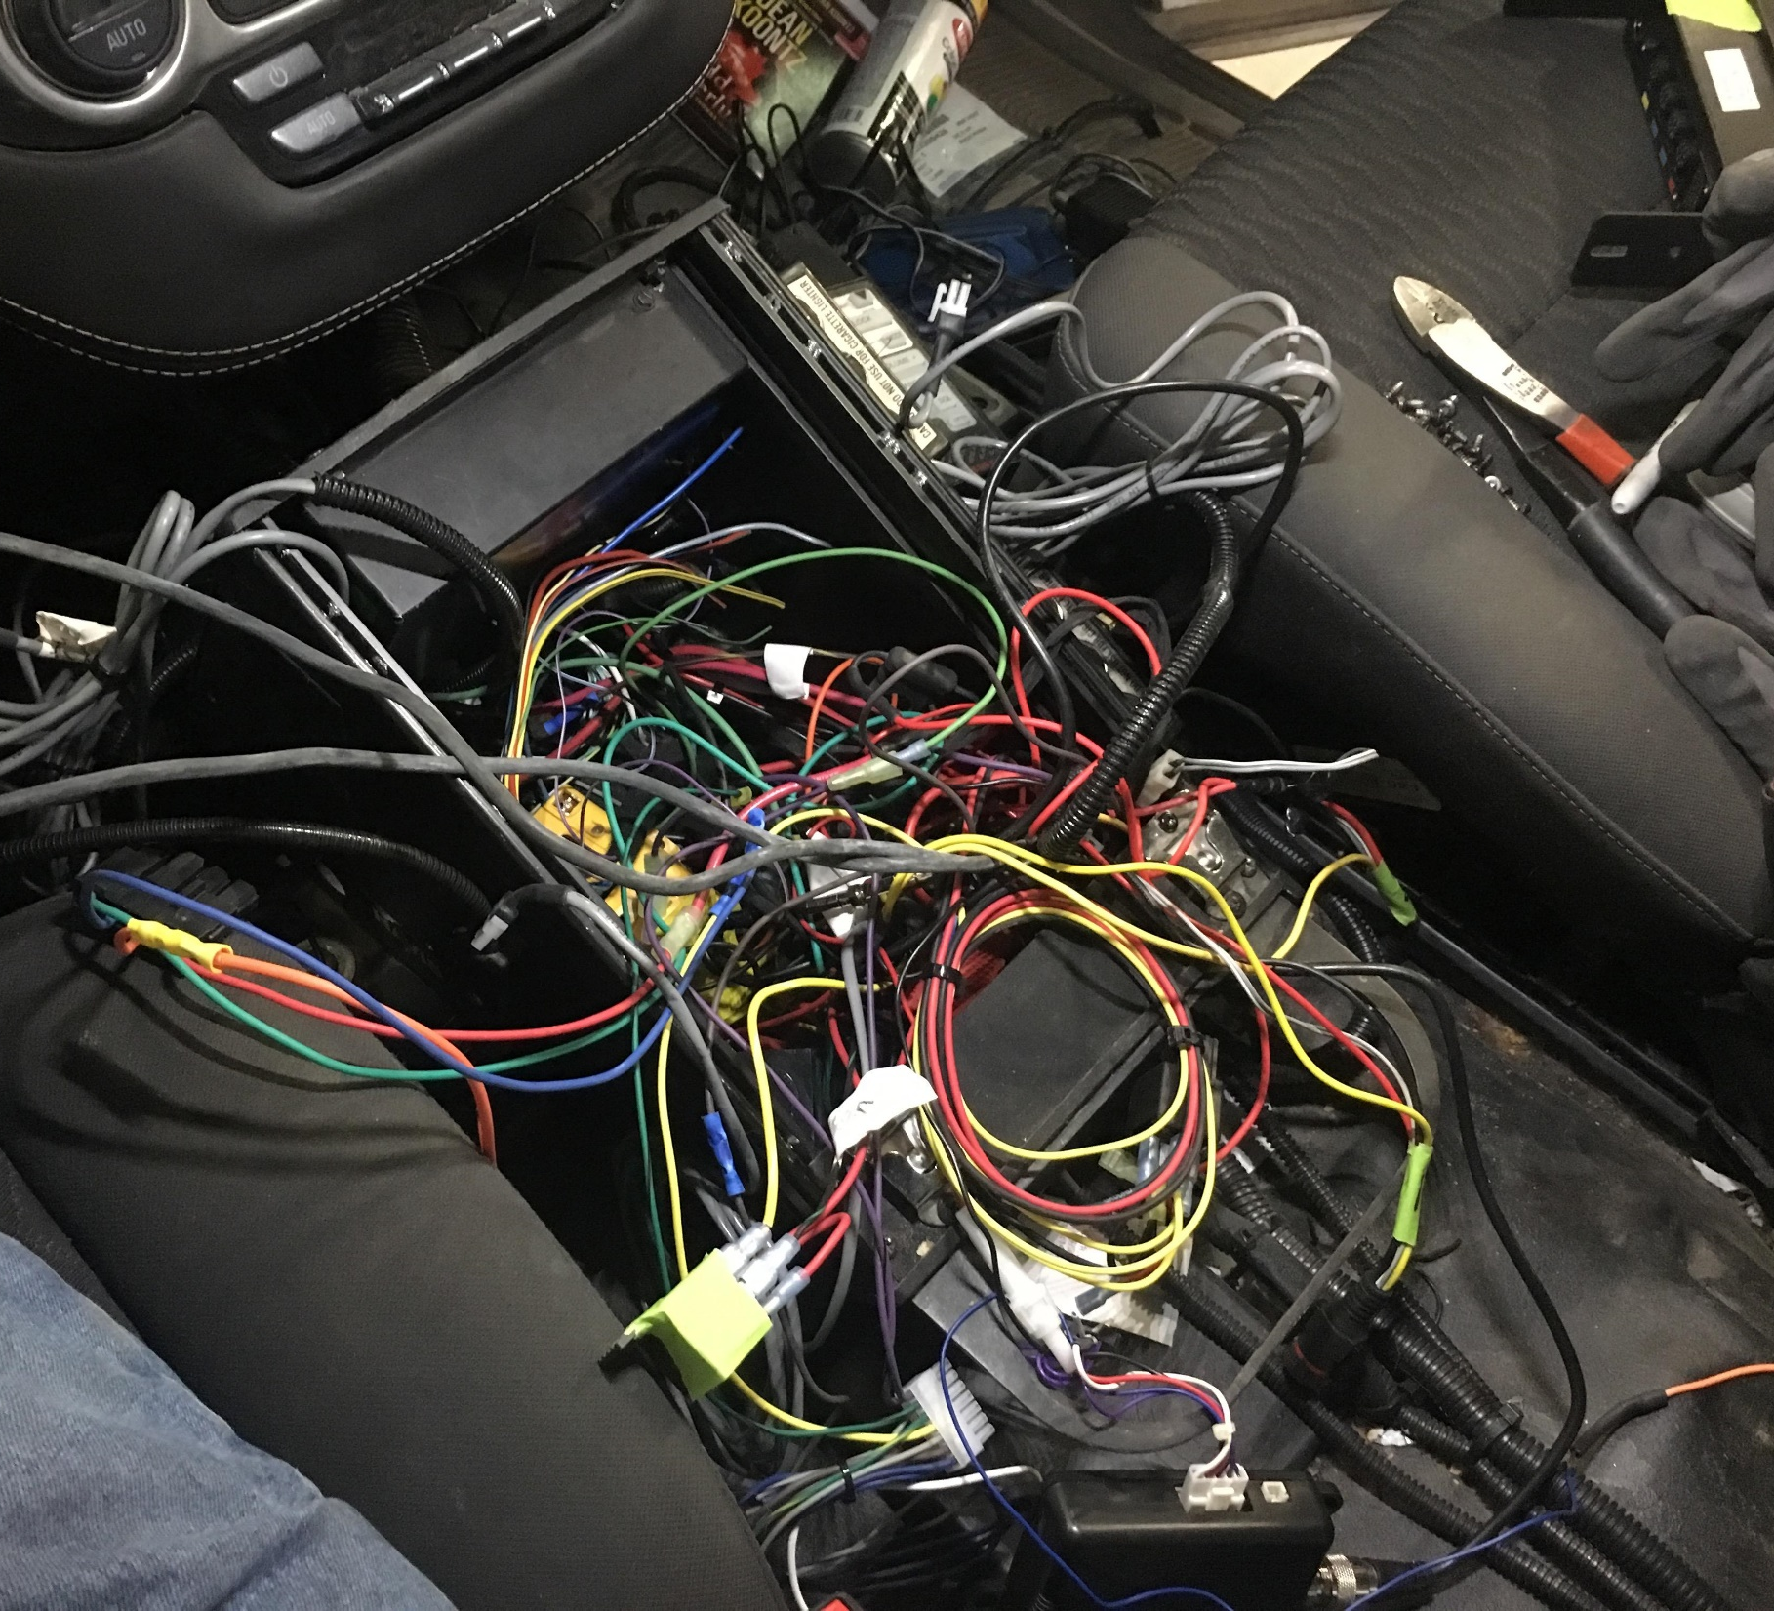

Motivation
Problem in communication between car component​
Bus (number of wires)​
Complicated​
Pervious solution : I2C didn’t reliable ​
Didn’t support for long distance ​
Unstable​
Work at low speed for long distance​
Critical Scenario : Emergency brake
2. Zafirul

Slide 3
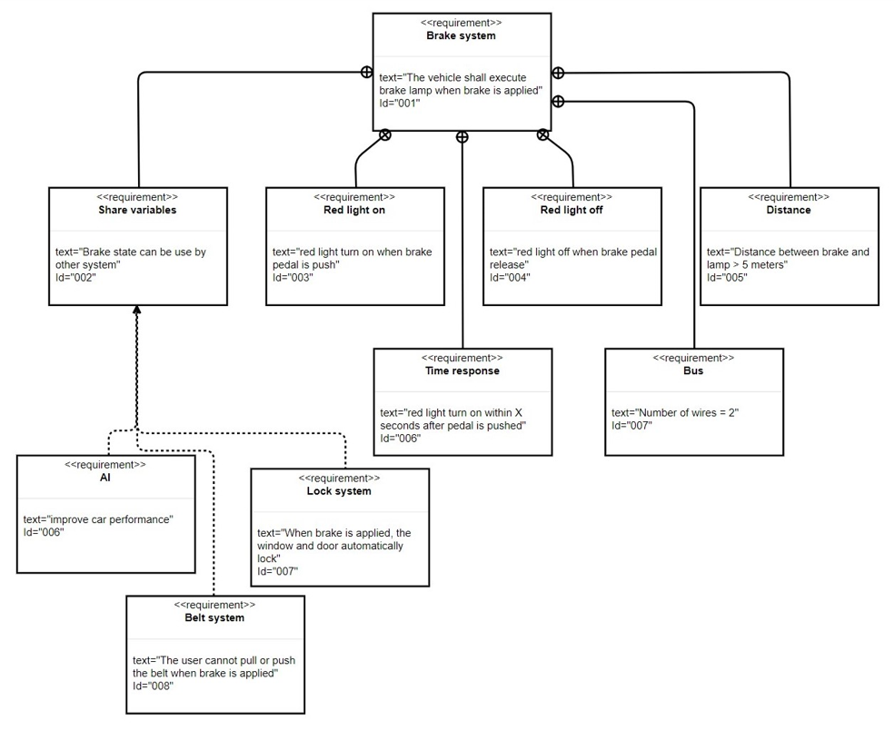

New Requirement

Slide 4
Solution : CAN
Controller Area Network (CAN) features that can solve the problem​
Highly integrated system using serial bus and communication protocol to connect intelligent devices for real time control application

Slide 5
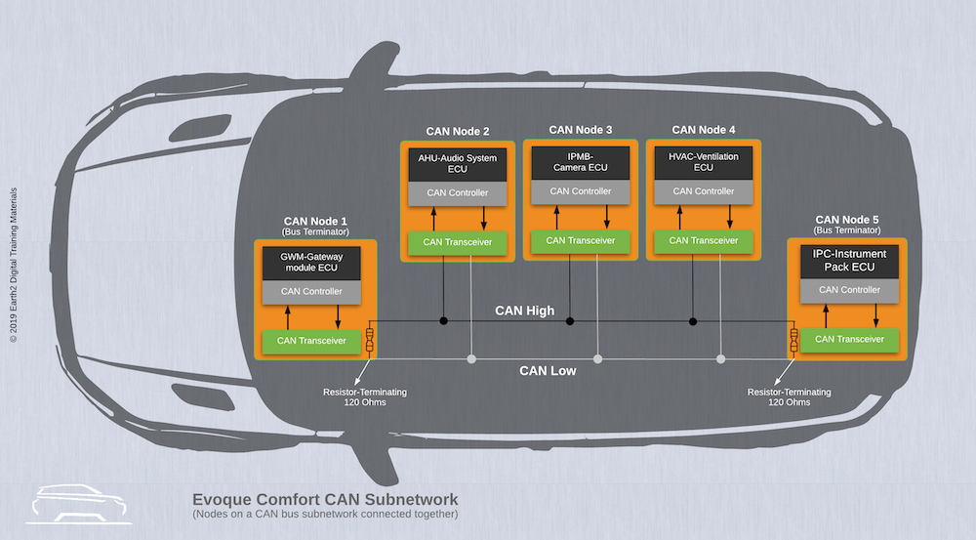

Slide 6
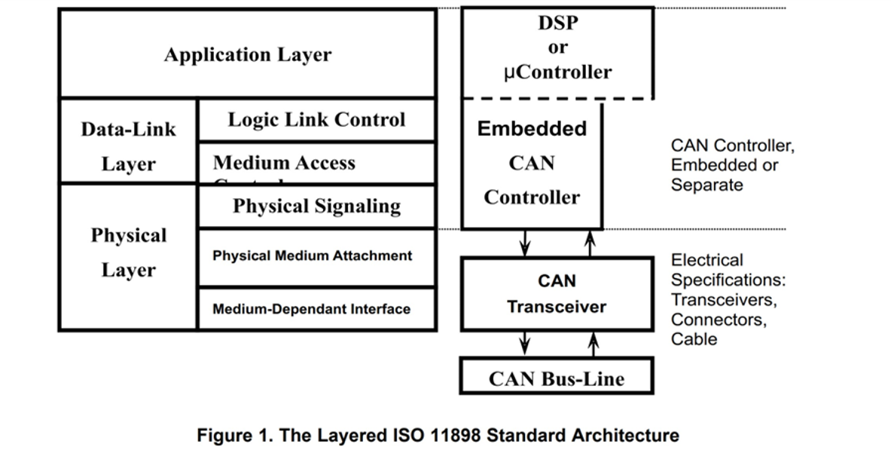
How does it work?​​

Slide 7

CAN message​
Arbitration​
Message type​
Valid frame​
Error checking and fault confinement

Slide 8

Approach
Model chosen scenario
Model solution for implementation
Use model to implement the software and hardware​

Slide 9
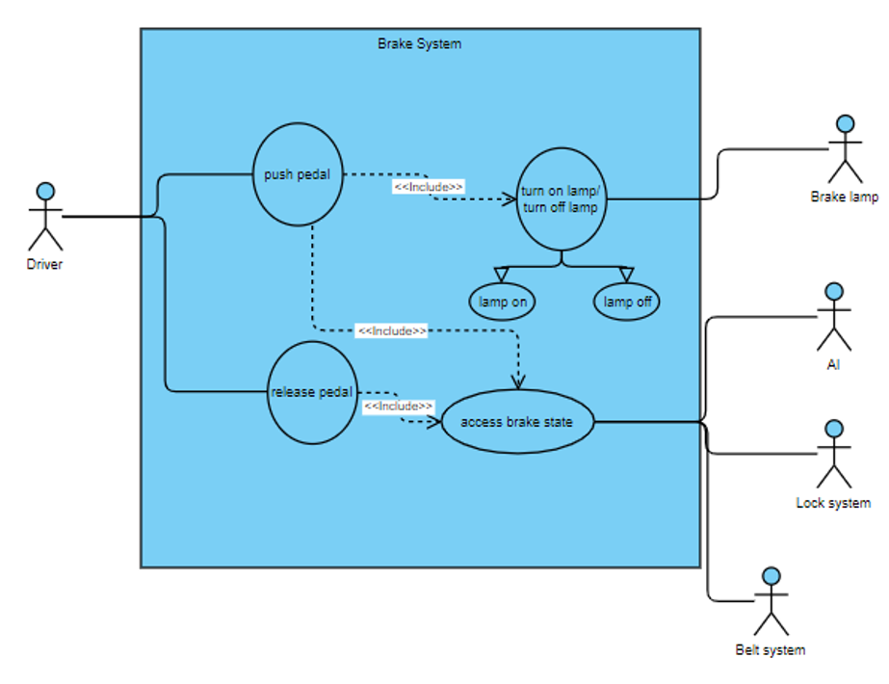
Use Case

Slide 10
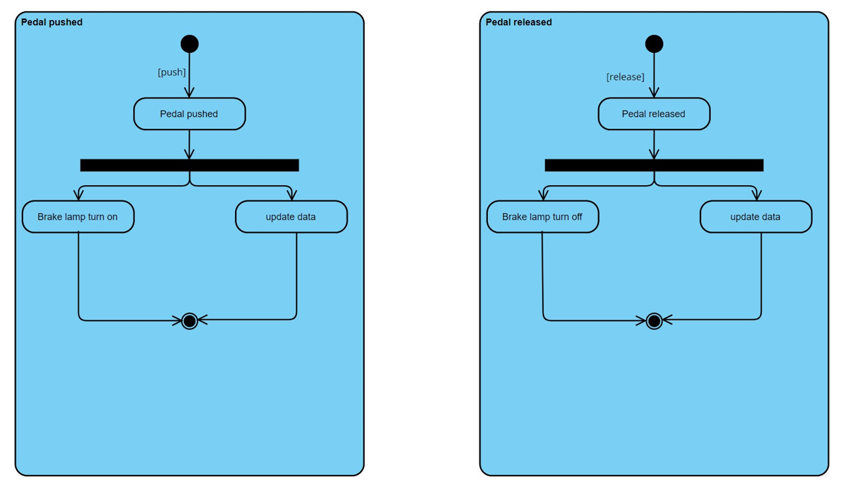
Activity

Slide 11
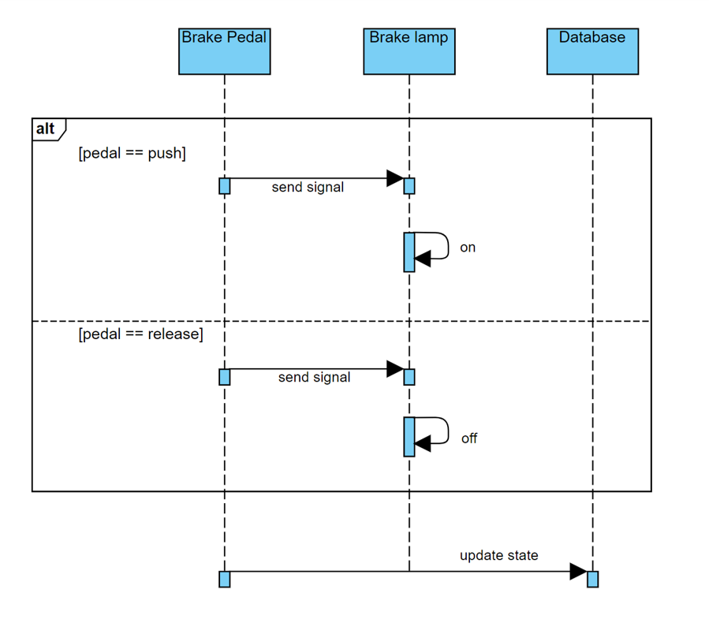
Sequence

Slide 12
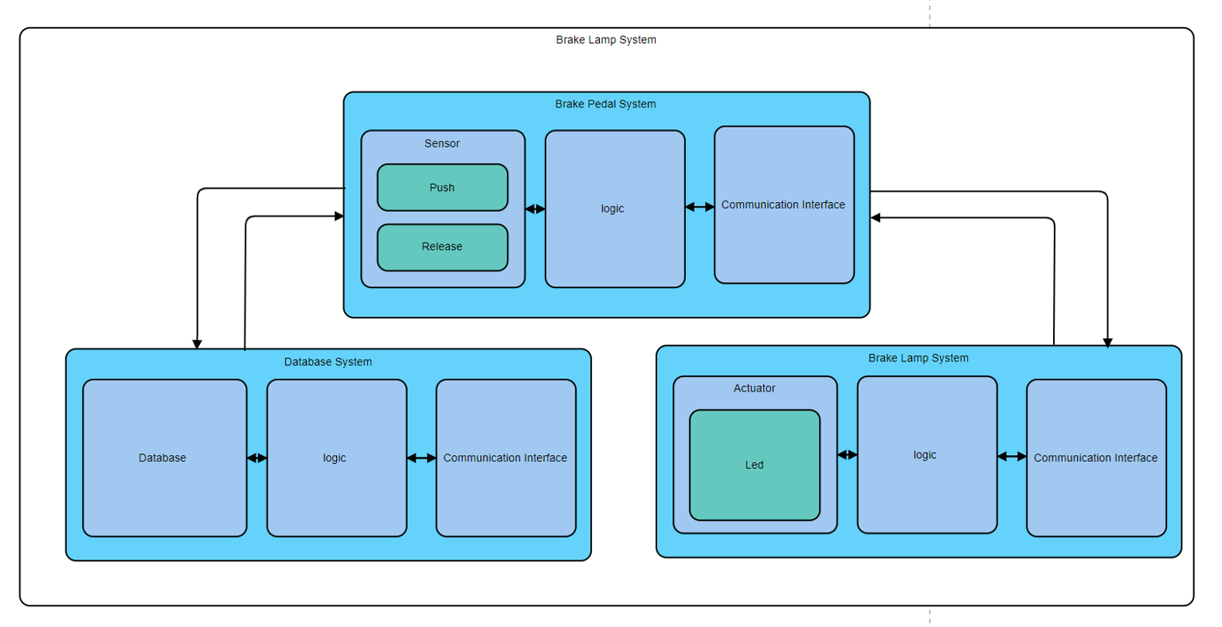
Architecture

Slide 13
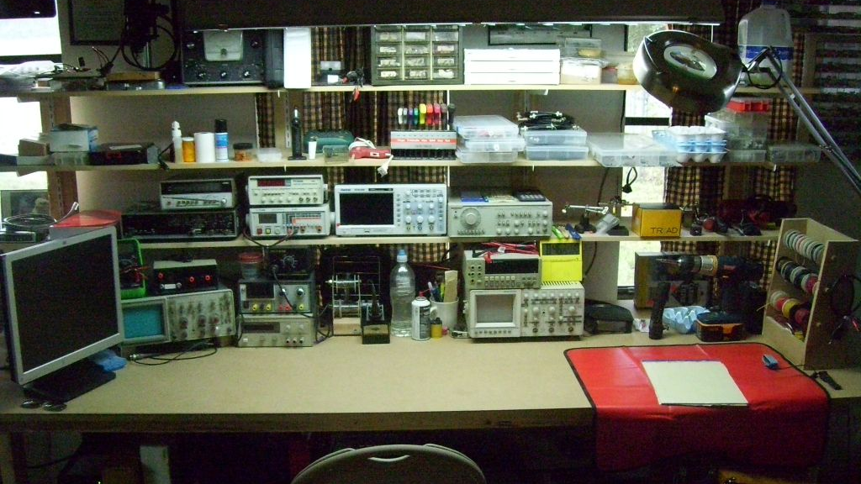
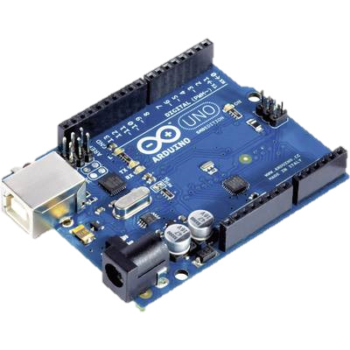
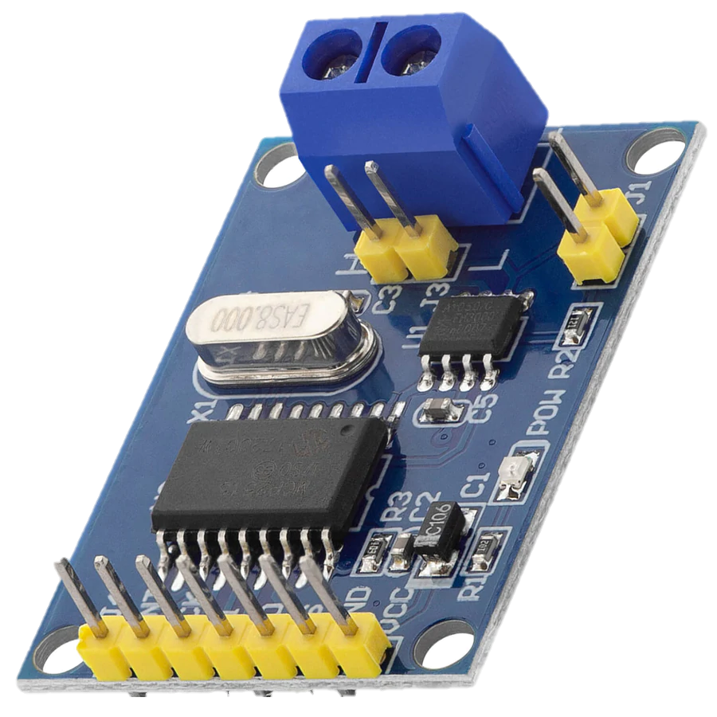
Implementation

Slide 14
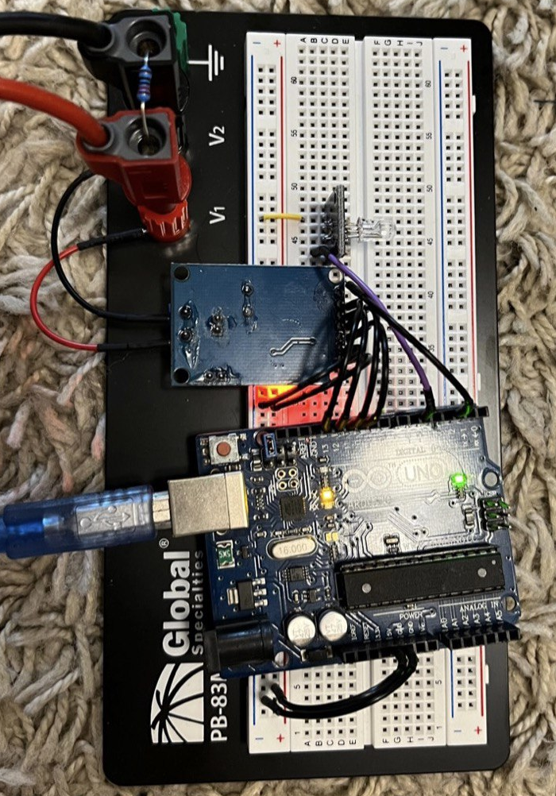
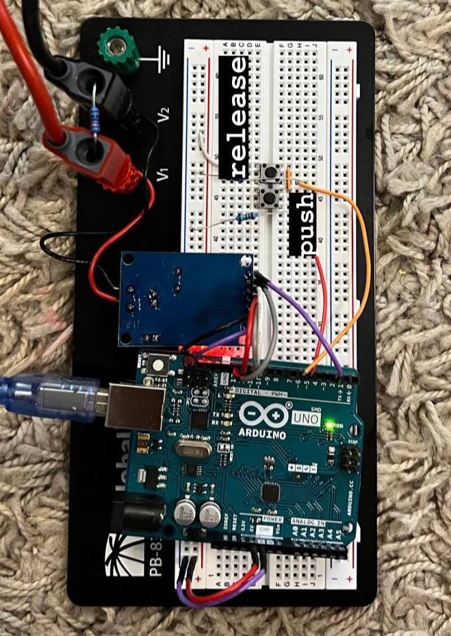
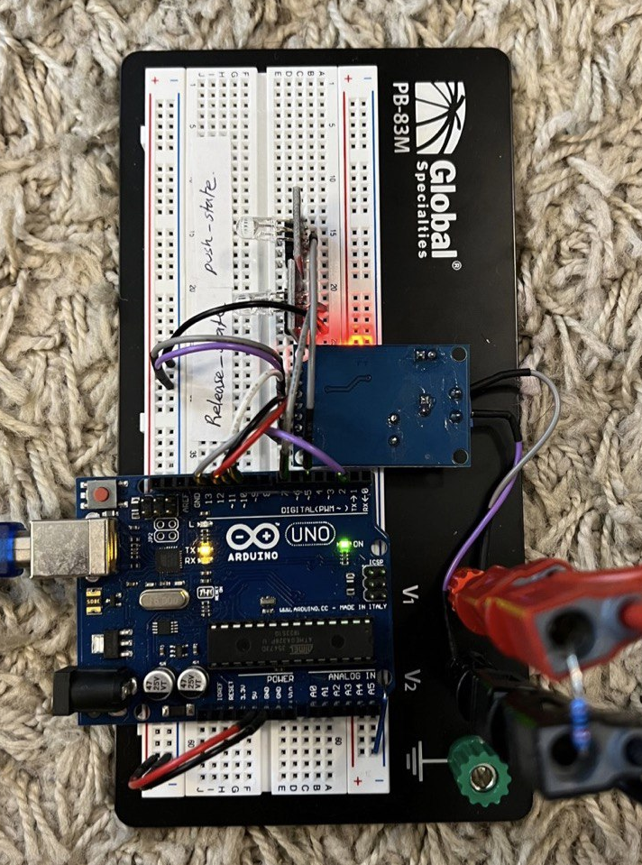


Sub System
Brake Lamp
Pedal
Database

Slide 15
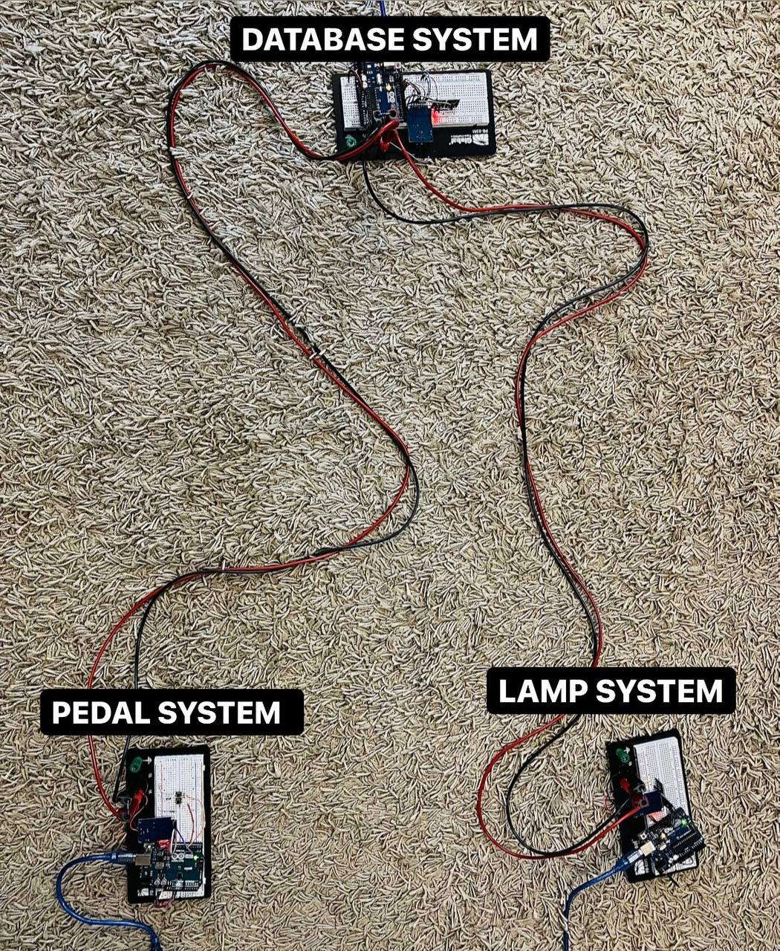
The Prototype
Brake System

Slide 16

Thank You

Slide 17
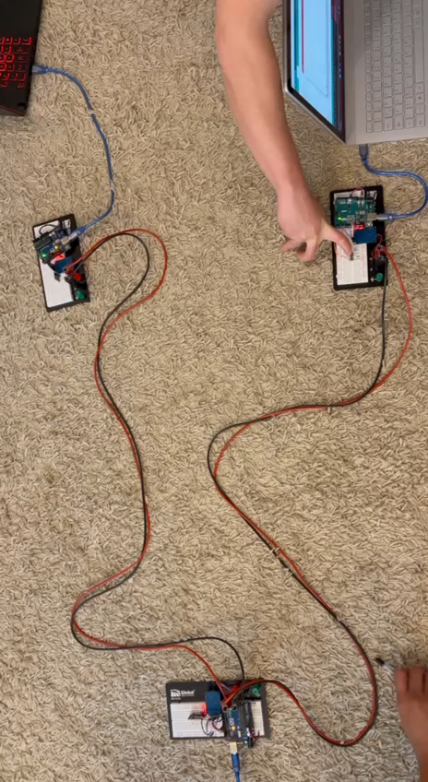
Hardware simulation

Slide 18
Reference :
S. Corrigan, “Introduction to the Controller Area Network (CAN) (rev. B),” Introduction to the Controller Area Network (CAN), Aug-2002. [Online]. Available: https://www.ti.com/lit/an/sloa101b/sloa101b.pdf. [Accessed: 16-May-2022].

